Slide 1
UPPER SIXTH ARTS
GEOGRAPHY
Lesson 13
Minerals and Mining
Notes:
Good morning, class, and welcome to our geography lesson. I am your geography teacher, Mr Kamdem. Today we are starting Lesson 13: Minerals and Mining.

Slide 2
CLASS INFO
Class, Chapter and Duration
Class | Upper Sixth Arts
Chapter | Module 6: Understanding and managing the dynamics of economic activities across the world in general and Cameroon in particular
Duration | 2 periods (2 × 50 minutes)
Notes:
This lesson is for Upper Sixth Arts. It belongs to Module 6: Understanding and managing the dynamics of economic activities across the world in general and Cameroon in particular. We shall need 2 periods to cover it.

Slide 3
IDENTIFICATION
Lesson Identification
Topic | Mineral Resources
Sub-topic | Mineral Resources
Lesson | Lesson 13: Minerals and Mining
Notions / Concepts | Mineral, ore, ferrous, non-ferrous, open-cast mining, shaft mining, placer mining, conservation.
Syllabus focus | Definition and classification; world distribution, producers and consumers; methods of extraction; problems; conservation.
Competence | Learners are able to classify minerals, describe mining methods and propose conservation measures.
Notes:
Our topic is Mineral Resources, and the sub-topic is Mineral Resources. The key notions we shall use today are: mineral, ore, ferrous, non-ferrous, open-cast mining, shaft mining, placer mining, conservation. At the end, you should be able to do this: learners are able to classify minerals, describe mining methods and propose conservation measures.

Slide 4

HOMEWORK CORRECTION
Correction of the Homework
Question (Lesson 11: Energy Resources):
List the energy sources used in your home and suggest how to save energy.
Notes:
Before we start the new lesson, let us correct the homework I gave you at the end of Lesson 11: Energy Resources. The question was: List the energy sources used in your home and suggest how to save energy. Take out your exercise books.

Slide 5
HOMEWORK CORRECTION
Correction: Possible Answer
Home energy: electricity (ENEO), firewood or charcoal, cooking gas, kerosene and petrol. To save energy: switch off lights, use low-energy bulbs, improved stoves and solar lamps.
Notes:
Here is a good answer. Home energy: electricity (ENEO), firewood or charcoal, cooking gas, kerosene and petrol. To save energy: switch off lights, use low-energy bulbs, improved stoves and solar lamps. Compare it with your own answer and correct your work in red.

Slide 6
LESSON PLAN
Lesson Plan
Correction of the homework
Objectives and recall
Real-life situation and action to take
Learning activities
Board summary
Evaluation, remediation and homework
Notes:
Here is the plan of our lesson today. First, we shall correct the homework. Then we shall look at the objectives and recall what you already know. After that, we shall study a situation from real life and the action to take, and do the learning activities. Finally, we shall copy the board summary, do the evaluation and the remediation, and I will give you the homework.

Slide 7
OBJECTIVES
Objectives
By the end of this lesson, you should be able to:
Classify minerals.
Describe the methods of mineral extraction.
Notes:
Take your time to copy this part; we will continue together.

Slide 8
OBJECTIVES
Objectives (continued)
Explain the problems of mining and ways of conserving minerals.
Notes:
By the end of this lesson, you should be able to do three things. Number 1: classify minerals. Number 2: describe the methods of mineral extraction. Number 3: explain the problems of mining and ways of conserving minerals.

Slide 9
PREVIOUS KNOWLEDGE
Previous Knowledge
Minerals are non-renewable.
Cameroon has bauxite, iron ore and gold.
Notes:
Let us first remember what you already know. Minerals are non-renewable. Cameroon has bauxite, iron ore and gold. Keep this in mind, because we shall build on it today.

Slide 10
REAL-LIFE SITUATION
Situation in Real Life
In the East Region, men dig pits by hand to find gold, while a large company plans an open-pit iron mine at Mbalam. Villagers worry about their rivers and farms.
Notes:
Listen carefully to this situation from real life. In the East Region, men dig pits by hand to find gold, while a large company plans an open-pit iron mine at Mbalam. Villagers worry about their rivers and farms. Think about it, because I am going to ask you some questions.

Slide 11
REAL-LIFE SITUATION
Situation: Question 1
What is the problem in the situation?
Notes:
Question 1: What is the problem in the situation? Think for a moment, then raise your hand to answer.

Slide 12
REAL-LIFE SITUATION
Answer
Mining brings money but can damage the environment.
Notes:
Good. Mining brings money but can damage the environment.

Slide 13
REAL-LIFE SITUATION
Situation: Question 2
Name two mining methods in the situation.
Notes:
Question 2: Name two mining methods in the situation. Think for a moment, then raise your hand to answer.

Slide 14
REAL-LIFE SITUATION
Answer
Artisanal digging and open-pit mining.
Notes:
Good. Artisanal digging and open-pit mining.

Slide 15
REAL-LIFE SITUATION
Situation: Question 3
Why do villagers worry?
Notes:
Question 3: Why do villagers worry? Think for a moment, then raise your hand to answer.

Slide 16
REAL-LIFE SITUATION
Possible Answer
Mining can pollute rivers and destroy farmland.
Notes:
Good. Mining can pollute rivers and destroy farmland.

Slide 17
ACTION TO TAKE
Action to Take
Exploit minerals responsibly and conserve them for the future.
Notes:
From this situation, the action we are working towards in this lesson is the following: exploit minerals responsibly and conserve them for the future.

Slide 18
JUSTIFICATION
Justification of the Lesson
This lesson helps us to understand mining and its effects on people and nature.
Notes:
Why is this lesson important for you? This lesson helps us to understand mining and its effects on people and nature.

Slide 19
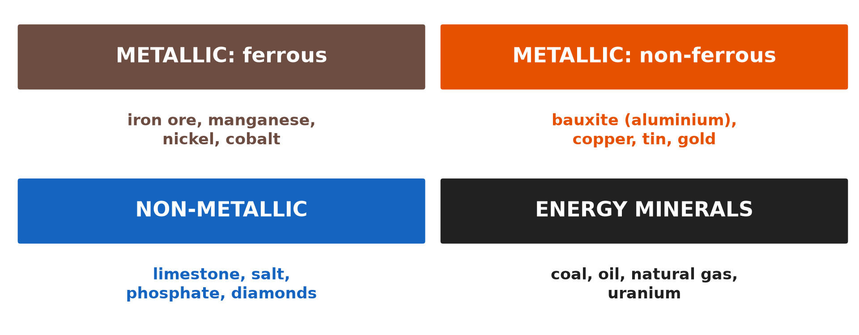
1. DEFINITION AND CLASSIFICATION
Activity 1
Types of minerals.
Notes:
Activity 1. Look carefully at this diagram: types of minerals. Observe every detail before I ask the question.

Slide 20
1. DEFINITION AND CLASSIFICATION
Activity 1: Question
Distinguish ferrous and non-ferrous minerals.
Notes:
Here is the question for Activity 1: Distinguish ferrous and non-ferrous minerals. Take one minute to think and write your answer in your rough notebook.

Slide 21
1. DEFINITION AND CLASSIFICATION
Activity 1: Answer
Ferrous minerals contain iron; non-ferrous minerals do not (bauxite, copper, gold).
Notes:
Let us check the answer together. Ferrous minerals contain iron; non-ferrous minerals do not (bauxite, copper, gold).

Slide 22
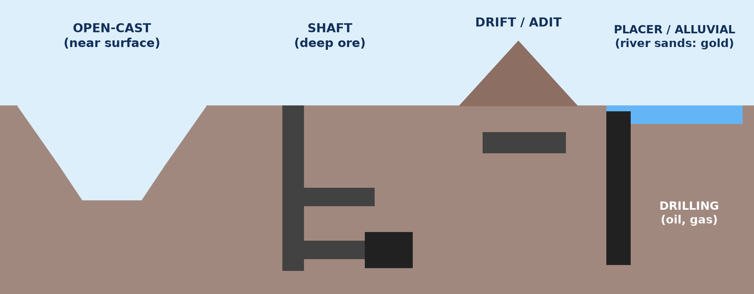
3. METHODS OF EXTRACTION
Activity 2
Methods of mining.
Notes:
Activity 2. Look carefully at this diagram: methods of mining. Observe every detail before I ask the question.

Slide 23
3. METHODS OF EXTRACTION
Activity 2: Question
When is open-cast mining used?
Notes:
Here is the question for Activity 2: When is open-cast mining used? Take one minute to think and write your answer in your rough notebook.

Slide 24
3. METHODS OF EXTRACTION
Activity 2: Answer
When the mineral is near the surface.
Notes:
Let us check the answer together. When the mineral is near the surface.

Slide 25

3. METHODS OF EXTRACTION
Activity 3
An open-pit mine.
Notes:
Activity 3. Look carefully at this picture: an open-pit mine. Observe every detail before I ask the question.

Slide 26
3. METHODS OF EXTRACTION
Activity 3: Question
Give one advantage and one disadvantage of open-pit mining.
Notes:
Here is the question for Activity 3: Give one advantage and one disadvantage of open-pit mining. Take one minute to think and write your answer in your rough notebook.

Slide 27
3. METHODS OF EXTRACTION
Activity 3: Answer
Advantage: cheap and safe. Disadvantage: huge scars on the landscape.
Notes:
Let us check the answer together. Advantage: cheap and safe. Disadvantage: huge scars on the landscape.

Slide 28

4. PROBLEMS
Activity 4
Small-scale gold miners.
Notes:
Activity 4. Look carefully at this picture: small-scale gold miners. Observe every detail before I ask the question.

Slide 29
4. PROBLEMS
Activity 4: Question
Give two problems of artisanal mining.
Notes:
Here is the question for Activity 4: Give two problems of artisanal mining. Take one minute to think and write your answer in your rough notebook.

Slide 30
4. PROBLEMS
Activity 4: Answer
Dangerous pits and polluted rivers (mercury).
Notes:
Let us check the answer together. Dangerous pits and polluted rivers (mercury).

Slide 31
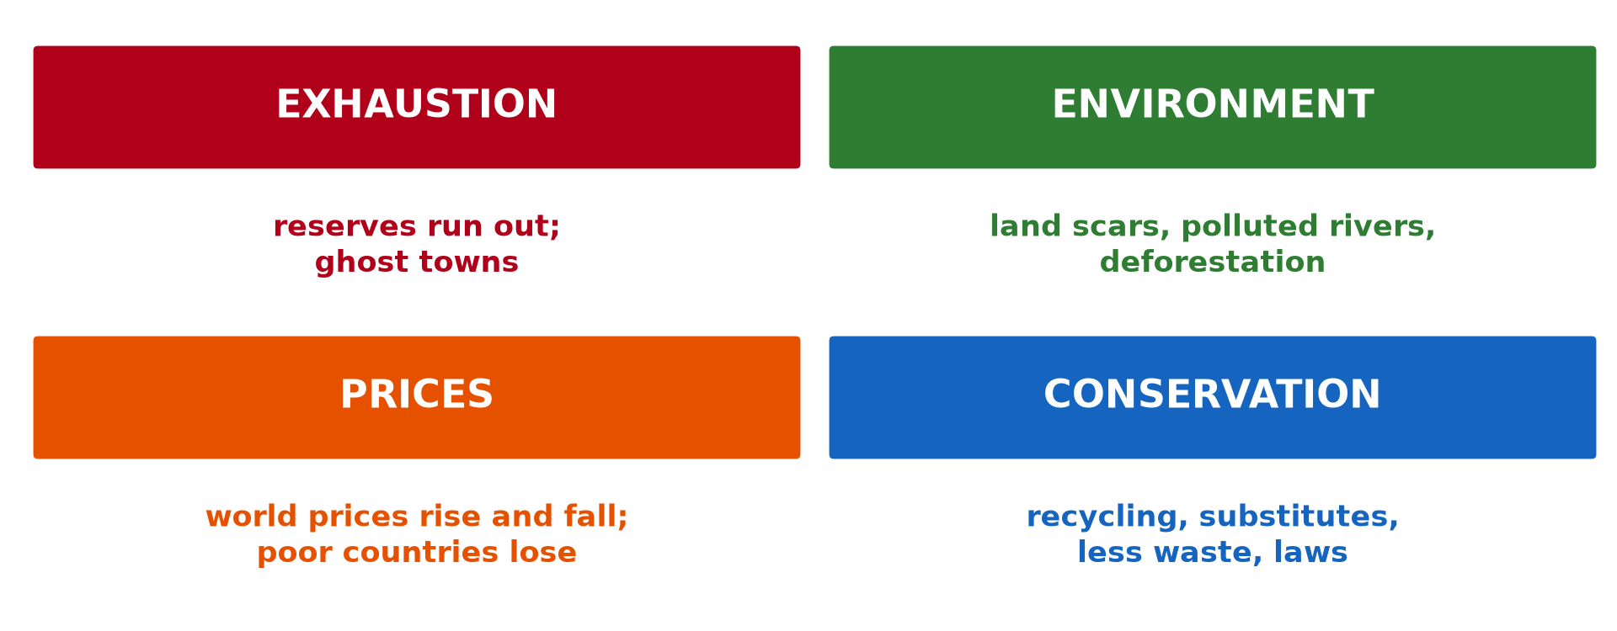
5. CONSERVATION
Activity 5
Problems and conservation.
Notes:
Activity 5. Look carefully at this diagram: problems and conservation. Observe every detail before I ask the question.

Slide 32
5. CONSERVATION
Activity 5: Question
Give two ways of conserving minerals.
Notes:
Here is the question for Activity 5: Give two ways of conserving minerals. Take one minute to think and write your answer in your rough notebook.

Slide 33
5. CONSERVATION
Activity 5: Answer
Recycling and using substitutes (also reducing waste).
Notes:
Let us check the answer together. Recycling and using substitutes (also reducing waste).

Slide 34
BOARD SUMMARY
Board Summary
Topic: Mineral Resources
Sub-topic: Mineral Resources
Lesson 13: Minerals and Mining
Notes:
Now we are going to copy the board summary. Write the title and the headings neatly in your notebooks. I will give you enough time for each slide, so do not rush.

Slide 35
BOARD SUMMARY
1. Definition and Classification
Minerals can be defined and classified as follows:
Mineral: It is a natural substance with a definite chemical composition found in the Earth's crust. An ore is a rock from which a mineral can be extracted profitably.
Notes:
Let us copy Definition and Classification. Minerals can be defined and classified as follows. On this slide we have Mineral. Write each point on a new line, with the key term first, and explain it in your own words when we revise. When you finish, we go to the next slide.

Slide 36
BOARD SUMMARY
1. Definition and Classification (continued)
Metallic minerals: Ferrous minerals contain iron (iron ore, manganese); non-ferrous minerals do not (bauxite, copper, tin, gold). Precious metals include gold and diamonds.
Notes:
We continue with Definition and Classification. On this slide we have Metallic minerals. Write each point on a new line, with the key term first, and explain it in your own words when we revise. When you finish, we go to the next slide.

Slide 37
BOARD SUMMARY
1. Definition and Classification (continued)
Non-metallic and energy minerals: Non-metallic minerals include limestone, salt and phosphates. Energy minerals are coal, oil, gas and uranium.
Notes:
We continue with Definition and Classification. On this slide we have Non-metallic and energy minerals. Write each point on a new line, with the key term first, and explain it in your own words when we revise.

Slide 38
BOARD SUMMARY
1. Definition and Classification
Illustration: classification of minerals
Notes:
Now draw this illustration in your notebook: classification of minerals. Give it a title and label it clearly.

Slide 39
BOARD SUMMARY
2. Distribution, Producers and Consumers
Minerals are unevenly distributed:
Distribution and producers: Iron ore comes mainly from Australia and Brazil, copper from Chile, bauxite from Australia and Guinea. South Africa and the DR Congo are rich in gold, cobalt and diamonds.
Notes:
Let us copy Distribution, Producers and Consumers. Minerals are unevenly distributed. On this slide we have Distribution and producers. Write each point on a new line, with the key term first, and explain it in your own words when we revise. When you finish, we go to the next slide.

Slide 40
BOARD SUMMARY
2. Distribution, Producers and Consumers (continued)
Consumers: China, the USA, Europe and Japan are the main consumers. LEDCs often export minerals as raw materials.
Notes:
We continue with Distribution, Producers and Consumers. On this slide we have Consumers. Write each point on a new line, with the key term first, and explain it in your own words when we revise.

Slide 41
BOARD SUMMARY
3. Methods of Mineral Extraction
Minerals are extracted by the following methods:
Open-cast (open-pit) mining: The surface is removed and the mineral dug out, when deposits are near the surface. It is cheap and safe but leaves large scars.
Notes:
Let us copy Methods of Mineral Extraction. Minerals are extracted by the following methods. On this slide we have Open-cast (open-pit) mining. Write each point on a new line, with the key term first, and explain it in your own words when we revise. When you finish, we go to the next slide.

Slide 42
BOARD SUMMARY
3. Methods of Mineral Extraction (continued)
Shaft and adit (drift) mining: Vertical shafts or horizontal tunnels reach deep deposits. It is costly and dangerous.
Placer (alluvial) mining and drilling: Gold and tin are washed from river sands; oil and gas are pumped from wells. Artisanal miners in the East use placer methods.
Notes:
We continue with Methods of Mineral Extraction. On this slide we have Shaft and adit (drift) mining and Placer (alluvial) mining and drilling. Write each point on a new line, with the key term first, and explain it in your own words when we revise.

Slide 43
BOARD SUMMARY
3. Methods of Mineral Extraction
Illustration: methods of mining
Notes:
Now draw this illustration in your notebook: methods of mining. Give it a title and label it clearly.

Slide 44
BOARD SUMMARY
4. Problems and Conservation
Mineral resources face problems and need conservation:
Problems: Minerals are exhaustible, prices fluctuate and mining destroys land, forests and rivers. Artisanal mining causes accidents, child labour and mercury pollution.
Notes:
Let us copy Problems and Conservation. Mineral resources face problems and need conservation. On this slide we have Problems. Write each point on a new line, with the key term first, and explain it in your own words when we revise. When you finish, we go to the next slide.

Slide 45
BOARD SUMMARY
4. Problems and Conservation (continued)
Conservation: Recycling, substitution with other materials and efficient use save minerals. Laws, land rehabilitation and responsible mining protect the environment.
Notes:
We continue with Problems and Conservation. On this slide we have Conservation. Write each point on a new line, with the key term first, and explain it in your own words when we revise.

Slide 46
BOARD SUMMARY
4. Problems and Conservation
Illustration: problems and conservation
Notes:
Now draw this illustration in your notebook: problems and conservation. Give it a title and label it clearly.

Slide 47
FORMATIVE EVALUATION
Evaluation 1
Describe two methods of mining.
Notes:
Now let us check what you have understood. Question 1: Describe two methods of mining. Answer in your exercise book.

Slide 48
FORMATIVE EVALUATION
Expected Answer
Open-cast: near-surface ore removed from a pit. Shaft: deep tunnels to reach ore.
Notes:
The expected answer is: open-cast: near-surface ore removed from a pit. Shaft: deep tunnels to reach ore. If you got it right, well done.

Slide 49
FORMATIVE EVALUATION
Evaluation 2
Give two ways of conserving minerals.
Notes:
Now let us check what you have understood. Question 2: Give two ways of conserving minerals. Answer in your exercise book.

Slide 50
FORMATIVE EVALUATION
Expected Answer
Recycling and substitutes.
Notes:
The expected answer is: recycling and substitutes. If you got it right, well done.

Slide 51
REMEDIATION
Remediation
Fill in the blanks:
Rock rich in a mineral is an ______.
Bauxite is a ______ mineral.
Washing river sands for gold is ______ mining.
Notes:
For those who need more practice, fill in the blanks in your exercise book. The answers are: number 1, ore; number 2, non-ferrous; number 3, placer.

Slide 52
HOMEWORK
Homework
Name two factories of your town and what they produce.
Notes:
For your homework: Name two factories of your town and what they produce. We shall correct it at the beginning of our next lesson.

Slide 53
NEXT LESSON
Next Lesson
Our next lesson will be on:
Lesson 14: What is Manufacturing?
Notes:
Our next lesson will be on Lesson 14: What is Manufacturing?. Thank you for your attention, and see you next time.

Slide 54
BILINGUAL GAME
Bilingual Game (Jeu Bilingue)
English | Français
Mineral | Le minerai, le minéral
Mine | La mine
Ore | Le minerai
Open-cast | À ciel ouvert
Recycling | Le recyclage
Gold | L'or
Notes:
Let us play the bilingual game. I say a word in English, and you give me the French word. Then we do the reverse.

Slide 55
LOGBOOK
Official Logbook (1/2)
Module / Topic | Mineral Resources
Lesson Title | Lesson 13: Minerals and Mining
Expected Learning Outcomes | Classify minerals. Describe the methods of mineral extraction. Explain the problems of mining and ways of conserving minerals.
Competence | Learners are able to classify minerals, describe mining methods and propose conservation measures.
Notes:
I record this information in the official logbook of the class after the lesson.

Slide 56
LOGBOOK
Official Logbook (2/2)
Matter Taught | Definition and Classification; Distribution, Producers and Consumers; Methods of Mineral Extraction; Problems and Conservation.
Evaluation | Formative evaluation and remediation exercise.
Homework | Name two factories of your town and what they produce.
Enrolment / Present / Absent | ____ / ____ / ____
Achievement | To be completed after the lesson.
Notes:
I complete the second page of the logbook: the matter taught, the evaluation, the homework and the attendance.

Slide 57
TEACHER'S NOTE
Teacher's Note
Timing: Homework correction, plan, objectives 8 min | Recall, situation, action 10 min | 5 activities 30 min | Board summary (copying) 30 min | Evaluation, remediation 10 min | Homework, next lesson 5 min | Logbook 7 min
Without the projector (Activity 1): list minerals.
Without the projector (Activity 2): draw the methods.
Without the projector (Activity 3): discuss mine scars.
Without the projector (Activity 4): discuss gold mining in the East.
Without the projector (Activity 5): discuss recycling metal.
Notes:
This slide is for me, the teacher: it gives the timing of the lesson and what to do if the projector is not available.

Slide 58
REFERENCES
References
National Geography Syllabus, MINESEC/IGE/IP-SS, 2019 — Module 6 (Economic Geography).
Photo, Activity 3: “2017-91-06” by Community Archives of Belleville & Hastings County, CC0 1.0, via Flickr (https://www.flickr.com/photos/134017397@N03/37070933734)
Photo, Activity 4: “Mining in Kailo” by Julien Harneis, CC BY-SA 2.0, via Flickr (https://www.flickr.com/photos/16935515@N00/1873057946)
Diagrams and animations: drawn for this lesson (Geography Department).
Notes:
These are the references and picture credits used to prepare this lesson.

